Slide 1

Program Analysis for Security
Dr. Sana Belguith
Adopted from slides provided by Dr. Sanjay Rawat
Adopted from courses from L. Mounier, Y. Lakhnech ( & S. Rawat) of Verimag & J. Michell of Stanford.

Slide 2
Lecture Agenda
Motivation for Program analysis
Types of program analysis
Static
Dynamic
A quick tour for static analysis techniques

Slide 3
Motivation
Heartbleed, WhatsApp double-free, Facebook account deletion bug etc.
How can you tell whether software you Develop or buy is safe to install and run?
Why do we need secure software development lifecycle-- at large-scale, it is not easy to find bugs manually which are more accessible now.
Analyzing it? But...

Slide 4
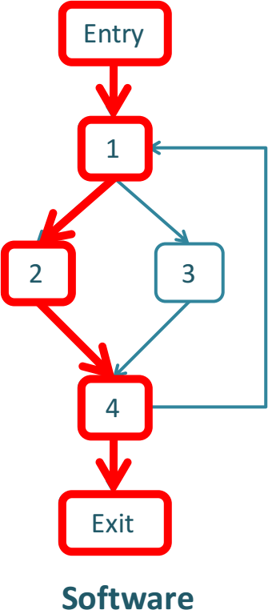
. . .

Slide 5
. . .
Behaviors

Slide 6
1
2
4
. . .
Behaviors

Slide 7
1
1
2
3
4
4
. . .
Behaviors

Slide 8
1
1
1
1
1
1
1
2
3
2
2
2
2
2
4
4
4
4
3
4
3
4
1
1
1
1
1
1
2
3
2
2
2
2
4
4
4
3
3
4
1
1
1
1
3
3
3
3
4
4
4
4
1 2
. . .
Behaviors

Slide 9
1
1
1
1
1
1
1
2
3
2
2
2
2
2
4
4
Manual testing only examines small subset of
₄ behaviors
4
4
4
3
4
3
4
1
1
1
1
1
1
2
3
2
2
2
2
4
3
3
4
1
1
1
1
3
3
3
3
4
4
4
4
1 2
. . .
Behaviors

Slide 10
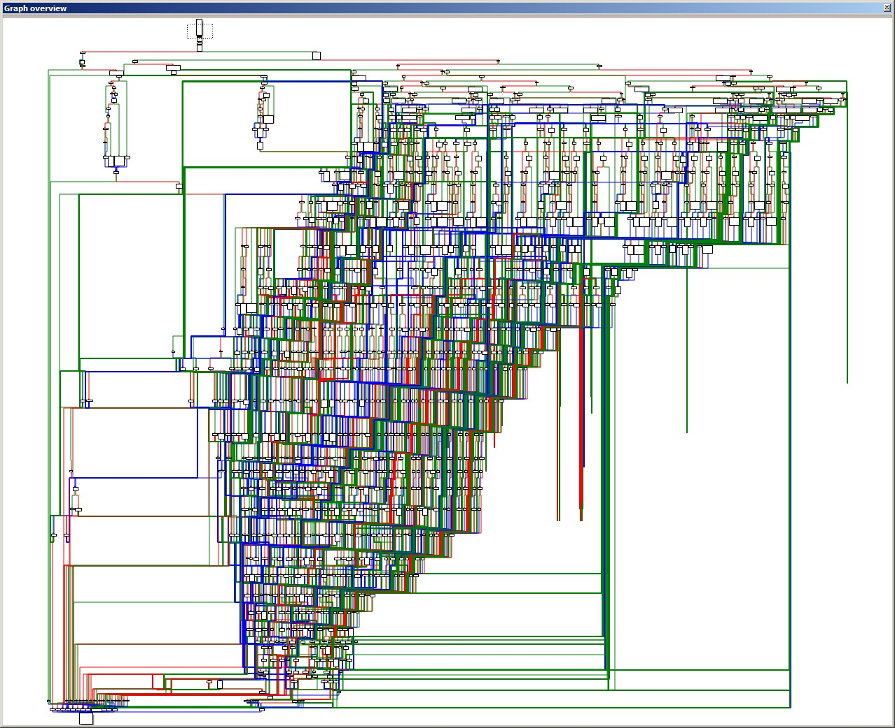
Real-world example….
Image: stackoverflow

Slide 11
Definition
Program analysis is the process of automatically analysing the behaviour of computer programs regarding a property such as correctness, reliability, safety and security.
Traditionally, it focuses on program optimization (as in compilers) and program correctness (as in verification). However, the same techniques are applied to other domains. So, we will study the code techniques first, irrespective of domain of application.
Types:
Static analysis: performed without executing the program.
Dynamic Analysis: performed at runtime.
Hybrid: a mix of the above.

Slide 12
Static Program Analysis

Slide 13
Static Program Analysis
Analysing the code (source or assembly) of the program without executing it.

Slide 14
Static Program Analysis
Analysing the code (source or assembly) of the program without executing it.
Scalability and precision are big challenges– for binary code, it is even more challenging (why?)

Slide 15
Static Program Analysis
Analysing the code (source or assembly) of the program without executing it.
Scalability and precision are big challenges– for binary code, it is even more challenging (why?)
Compilers make heavy use of such analyses.

Slide 16
Static Program Analysis
Analysing the code (source or assembly) of the program without executing it.
Scalability and precision are big challenges– for binary code, it is even more challenging (why?)
Compilers make heavy use of such analyses.
Given the availability of the code, it can analyse every component and path of the application.

Slide 17
Static Program Analysis
Tools:
LLVM provides a very robust platform to perform several static analyses (on source code).
For binary code, there exist several tools– IDA, Ghidra, Miasm, angr etc.
Typical examples:
data-flow analysis, abstract interpretation, type system, model checking.
For this course, we will be using Ghidra for learning some binary code analysis!

Slide 18
Dynamic Program Analysis

Slide 19
Dynamic Program Analysis
Analyzing the program at runtime (Yes, just like a debugger!).

Slide 20
Dynamic Program Analysis
Analyzing the program at runtime (Yes, just like a debugger!).
Very precise, with reasonable scalability.

Slide 21
Dynamic Program Analysis
Analyzing the program at runtime (Yes, just like a debugger!).
Very precise, with reasonable scalability.
Analysis is limited to the executed code of the program. Thus coverage is a problem.

Slide 22
Dynamic Program Analysis
Analyzing the program at runtime (Yes, just like a debugger!).
Very precise, with reasonable scalability.
Analysis is limited to the executed code of the program. Thus coverage is a problem.
Have been very useful for profiling (e.g. linux perftool).

Slide 23
Dynamic Program Analysis
Analyzing the program at runtime (Yes, just like a debugger!). Very precise, with reasonable scalability.
Analysis is limited to the executed code of the program. Thus coverage is a problem.
Have been very useful for profiling (e.g. linux perftool).
Often used with static/dynamic instrumentation (We will talk about dynamic binary Instrumentation).

Slide 24
Dynamic Program Analysis
Existing tools:
Intel Pin, Dyninst, Valgrind etc.
From security standpoint-- Fuzzing (we will talk about it.)
For this course, we will be using Intel Pintool.

Slide 25
Soundness, Completeness
Property
Soundness
Completeness
Definition
“Sound for reporting correctness”
Analysis says no bugs → No bugs
or equivalently
Analysis says bug → It is a bug
Analysis says True → True
“Complete for reporting correctness”
No bugs → Analysis says no bugs
True → analysis says True

Slide 26
Complete
Incomplete
Sound
Unsound

Slide 27
Complete
Incomplete
Reports all errors Reports no false alarms
Sound
Unsound

Slide 28
Complete
Incomplete
Reports all errors Reports no false alarms
Undecidable
Sound
Unsound

Slide 29
Complete
Incomplete
Reports all errors Reports no false alarms Undecidable | Reports all errors May report false alarms
Sound
Unsound

Slide 30
Complete
Incomplete
Reports all errors Reports no false alarms Undecidable | Reports all errors May report false alarms Decidable
Sound
Unsound

Slide 31
Complete
Incomplete
Reports all errors Reports no false alarms Undecidable | Reports all errors May report false alarms Decidable
May not report all errors Reports no false alarms
Sound
Unsound

Slide 32
Complete
Incomplete
Reports all errors Reports no false alarms Undecidable | Reports all errors May report false alarms Decidable
May not report all errors Reports no false alarms Decidable
Sound
Unsound

Slide 33
Complete
Incomplete
Reports all errors Reports no false alarms Undecidable | Reports all errors May report false alarms Decidable
May not report all errors Reports no false alarms Decidable | May not report all errors May report false alarms
Sound
Unsound

Slide 34
Complete
Incomplete
Reports all errors Reports no false alarms Undecidable | Reports all errors May report false alarms Decidable
May not report all errors Reports no false alarms Decidable | May not report all errors May report false alarms Decidable
Sound
Unsound

Slide 35
Common Program Analysis Techniques

Slide 36
Objectives
give some indications on general optimization techniques:
data-flow analysis
register allocation
software pipelining
Etc.
describe the main data structures used:
Call graph
control flow graph
intermediate code (e.g., 3-address code)
Static Single Assignment form (SSA)
etc

Slide 37
Generic Approach
Decide – Intraprocedural or Interprocedural
Intraprocedural-- per function analysis (disregarding side effect of function calls)
Interprocedural- function analysis with considering side effects of function calls
generation of a control flow graph (CFG)
(optional) generation of interprocedural CFG (ICFG)
Data-flow analysis of the (I)CFG

Slide 38
IR: 3-address code (TAC mode)
Intermediate Representation “high-level” assembly code:
binary logic and arithmetic operators
use of temporary memory location ti
assignments to variables, temporary locations
a label is assigned to each instruction

Slide 39
IR: 3-address code (TAC mode)
Intermediate Representation “high-level” assembly code:
binary logic and arithmetic operators
use of temporary memory location ti
assignments to variables, temporary locations
a label is assigned to each instruction
L1: t1 = var2 + var3 L2: t2 = func(A)
L3: var1= t1+t2
var1= (var2+ var3) + func(A)

Slide 40
Basic Block (BB)
A maximal sequence of instructions with single entry and single exit
=> execution of BB is atomic (under normal condition)

Slide 41
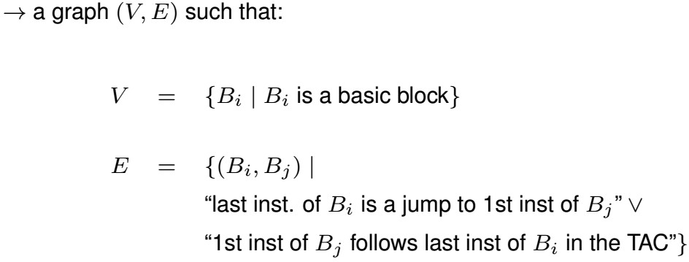
Control Flow Graph (CFG)
A representation of how the execution may progress inside a given function

Slide 42
Call Graph
Computed for a whole program (i.e. interprocedural by definition)
Represented as a directed graph (V,E)
where V = {Fi|Fi is a function}
E ={(Fi,Fj)|Fi calls Fj}

Slide 43
Intraprocedural Computation over CFG
associate (local) properties to entry/exit points of BBs, e.g. set of active variables, set of available expressions, etc.)
propagate them along CFG paths
update each BB (and CFG edges) according to these global properties

Slide 44
Dataflow Analysis
Static computation of the data related properties of the program

Slide 45
Dataflow Analysis
Static computation of the data related properties of the program

Slide 46
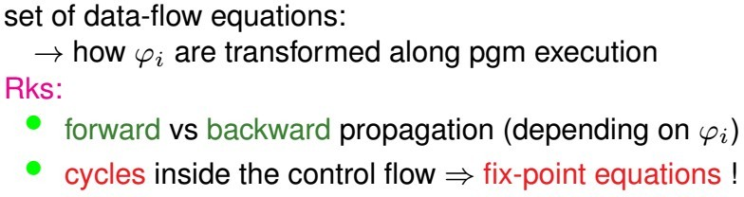
Dataflow Analysis
Static computation of the data related properties of the program

Slide 47
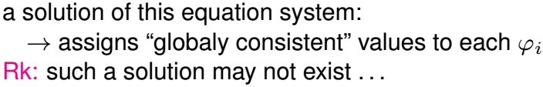
Dataflow Analysis
Static computation of the data related properties of the program

Slide 48
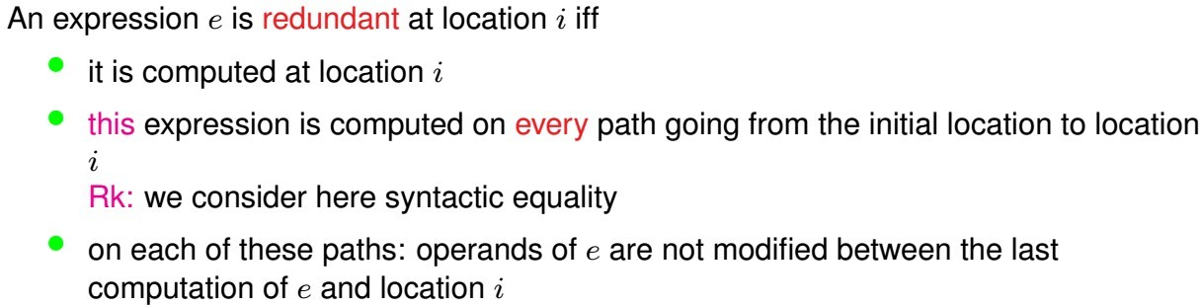
Example: redundant Expression

Slide 49
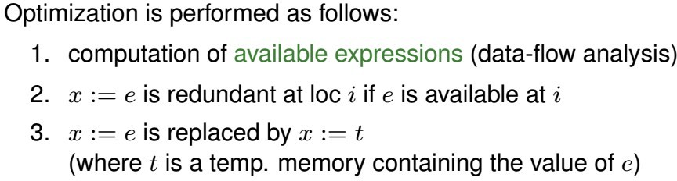
Example: redundant Expression

Slide 50
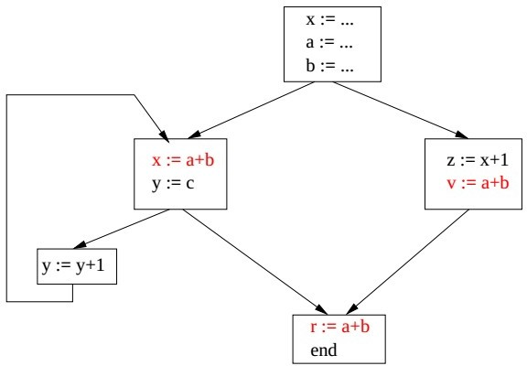
Example conti..

Slide 51
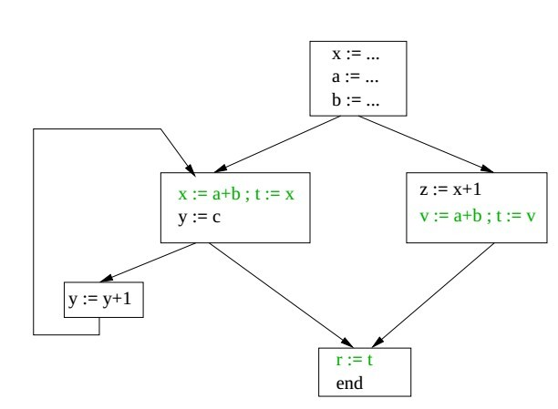
Example conti..

Slide 52
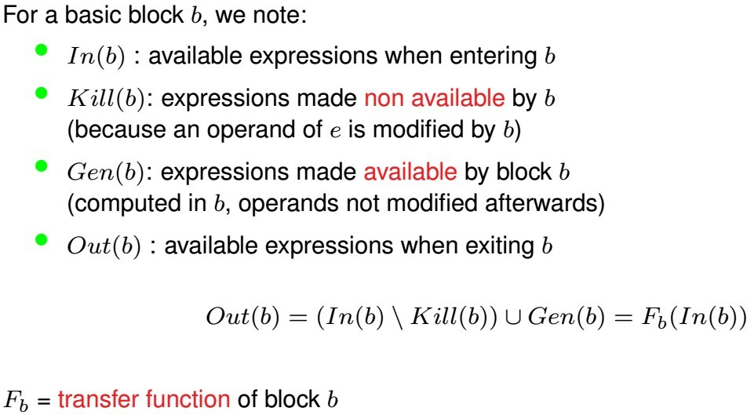
Dataflow Eqn for available expressions 1/2

Slide 53
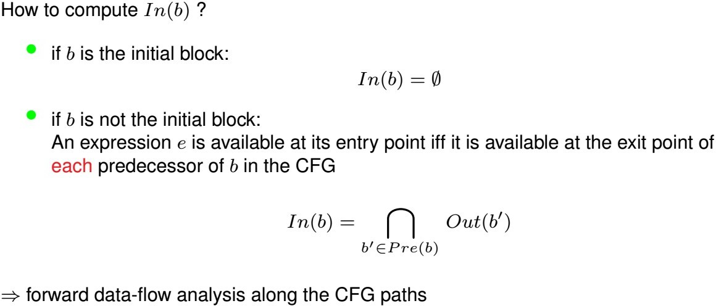
Dataflow Eqn for available expressions 2/2

Slide 54
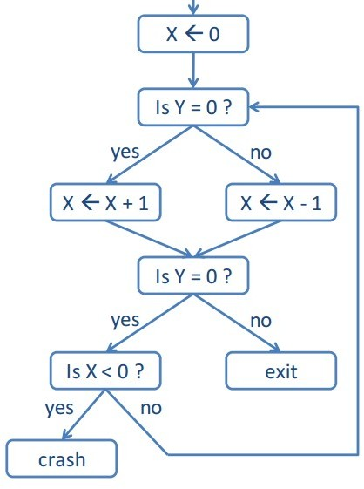
Simple Program

Slide 55
X=0
X = X + 1
X=1

Slide 56
X=0
^{d}in
X = X + 1
f
X=1
^{d}out

Slide 57
dataflow elements
X=0
^{d}in
X = X + 1
f
X=1
^{d}out

Slide 58
dataflow elements
X=0
^{d}in
X = X + 1
f
X=1
^{d}out
transfer function

Slide 59
dataflow elements
X=0
^{d}in
f
d_{out} = f(d_{in})
X = X + 1
X=1
^{d}out
transfer function

Slide 60
dataflow elements
X=0
^{d}in
f
d_{out} = f(d_{in})
X = X + 1
X=1
^{d}out
dataflow equation
transfer function

Slide 61
dataflow elements
X=0
^{d}in
f
d_{out} = f(d_{in})
X = X + 1
X=1
^{d}out
dataflow equation
transfer function

Slide 62
X=0
X=0
^{d}in1
X = X + 1
f1
^{d}out1 ^{= f}1^{(d}in1^{) d}in2^{= d}out1 ^{d}out2 ^{= f}2^{(d}in2⁾
X=1
^{d}out1
X=1
d
in2
Is Y = 0 ?
f2
X=1
^{d}out2

Slide 63
^{d}out1 ^{= f}1^{(d}in1⁾
^{d}in1
^{d}in2
d = f (d )
f
f
out2 2 in2
1
2
^{d}out1
^{d}out2
^{d}join ^{= d}out1 ^{⊔ d}out2 ^{d}join ^{= d}in3
^{d}out3 ^{= f}3^{(d}in3⁾
^{d}join ^{d}in3
f₃
^{d}out3

Slide 64
^{d}out1 ^{= f}1^{(d}in1⁾
^{d}in1
^{d}in2
d = f (d )
f
f
out2 2 in2
1
2
^{d}out1
^{d}out2
^{d}join ^{= d}out1 ^{⊔ d}out2 ^{d}join ^{= d}in3
^{d}out3 ^{= f}3^{(d}in3⁾
least upper bound operator Example: union of possible values
^{d}join ^{d}in3
f₃
^{d}out3

Slide 65
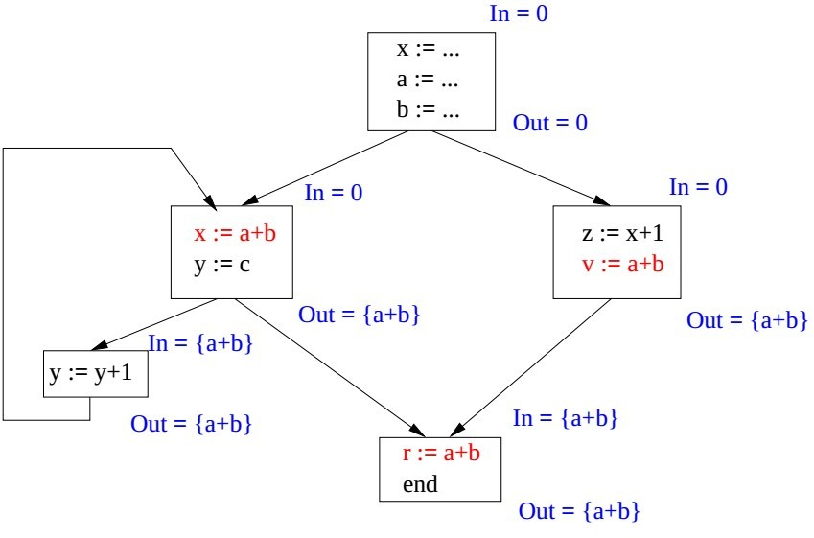
Back to Example

Slide 66
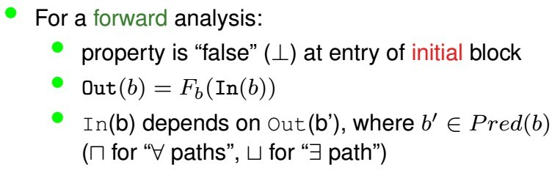
Generalization

Slide 67
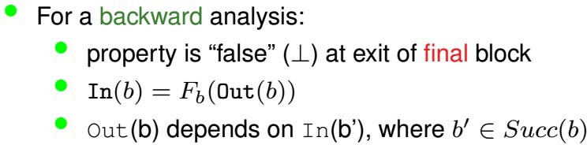
Generalization

Slide 68
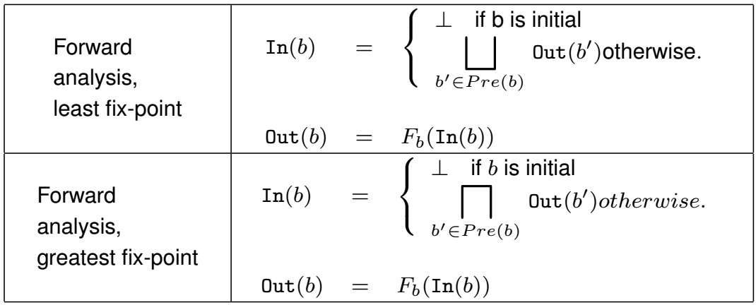
Forward Analysis

Slide 69
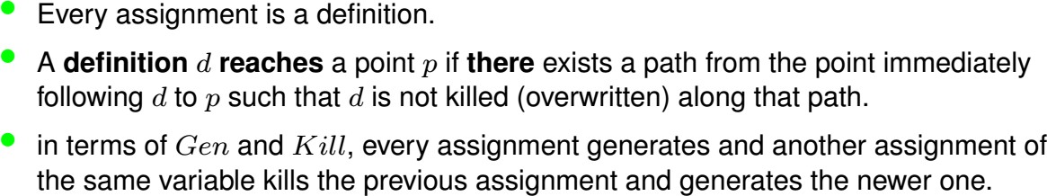
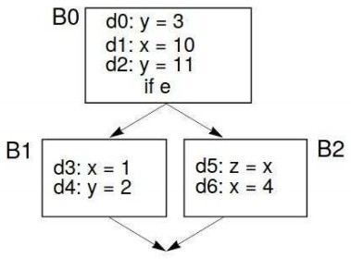
Reaching Definition
Least fixed point
i.e. union at phi node

Slide 70
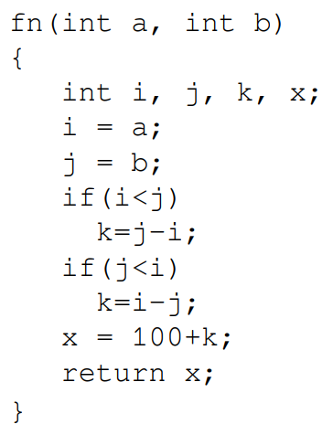
Bug Detection- Uninitialized use
●
A variable is used before it is defined → undefined behaviour class of bugs
Reaching def. Type analysis,
but with greatest fixed-point, i.e. all paths
Dataflow element: set of defined (Gen) vars
i.e. a value is assigned
We stop when we do not get reaching def of a variable being used in a instruction.

Slide 71
i = a;
j = b; if(i<j)
T
F
k=j-i;
if(j<i)
T
F
k=i-j;
x = 100+k;
return x;

